Slide 1
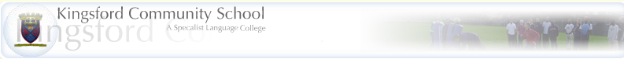

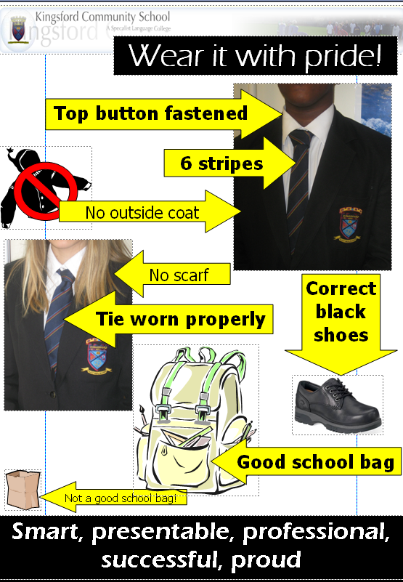
The Kingsford 7 – prepared for learning
Planners
out every
lesson
3
1
4
5
Have you
written the date
and objectives
yet?
2
Pens, pencil, ruler, rubber.
7
Do you know
how to move
on to the
next level?
6
Homelearning is recorded in the school planner
At Kingsford I focus, improve, achieve and succeed

Slide 2
Families and Households
Learning objective: To revise the topic of families and households

Slide 3
Interactive quiz
http://www.tutor2u.net/sociology/quiz/familyuk1/quiz.html

Slide 4
Exam practise
To what extent would sociologists agree that the nuclear family remains the dominant type of family that exists in Britain today

Slide 5
Here's How:
Before you begin writing, decide on your answer to the question asked of you. This is your basic thesis.
Before you begin writing, decide on what three pieces of evidence/support you will use to prove your thesis.
Write your introductory paragraph. Place your thesis along with your three pieces of evidence in order of strength (least to most) at the end of this paragraph.
Write the first paragraph of your body. You should begin by restating your thesis, focussing on the support of your first piece of evidence.
End your first paragraph with a transitional sentence that leads to paragraph number two.
Write paragraph two of the body focussing on your second piece of evidence. Once again make the connection between your thesis and this piece of evidence.
End your second paragraph with a transitional sentence that leads to paragraph number three.
Repeat step #6 using your third piece of evidence.
Begin your concluding paragraph by restating your thesis. Include the three points you've used to prove your thesis.

Slide 6
How to complete the question
classify: Into what general category/categories does this idea belong?
compare: What are the similarities among these ideas? What are the differences?
contrast: What are the differences between these ideas?
critique: What are the strengths and weaknesses of this idea?
define: What does this word or phrase mean?
describe: What are the important characteristics or features of this idea?
evaluate: What are the arguments for and against this idea? Which arguments are stronger?
explain: Why is this the case?
identify: What is this idea? What is its name?
interpret: What does this idea mean? Why is it important?
justify: Why is this correct? Why is this true?
outline: What are the main points and essential details?
summarize: Briefly, what are the important ideas?
trace: What is the sequence of ideas or order of events?

Slide 7
How to answer an essay question- video
http://www.ehow.com/video_4436819_answer-question-essay.html

Slide 8

Peer assessment - Student Mark-Scheme
Back to AFL Tools
Ask students to produce their own
mark-schemes working individually or
in groups. They can then peer- or
self-assess work in accordance
with these schemes.
Talk about the purpose of a mark-
scheme with students – judgement,
communication, standardisation etc.

Slide 9
Exam practise
To what extent would sociologists agree that the nuclear family remains the dominant type of family that exists in Britain today (9)

Slide 10
How to complete your extended question
Get right to the point
State your main point in the first sentence
Use your first paragraph to provide an overview of your essay.
Use the rest of your essay to discuss these points in more detail.

Slide 11
Writing & answering:
Begin with a strong first sentence that states the main idea of your essay.
Continue this first paragraph by presenting key points

Slide 12
Develop your argument
Begin each paragraph
with a key point from the introduction
Develop each point
in a complete paragraph
Clarify answers when in doubt.
It is better to say according to the ------ perspective, rather than to say "in sociology" when you can't remember specific sociologists.

Slide 13
Review/ Conclusion:
Summarize in your last paragraph
Restate your central idea and indicate why it is important, ensuring that you directly answer the question. Remember to allow time to review all questions

Slide 14
Homework
Revise for your end of unit assessment (Families and Households) Thursday 25th March

